Slide 1
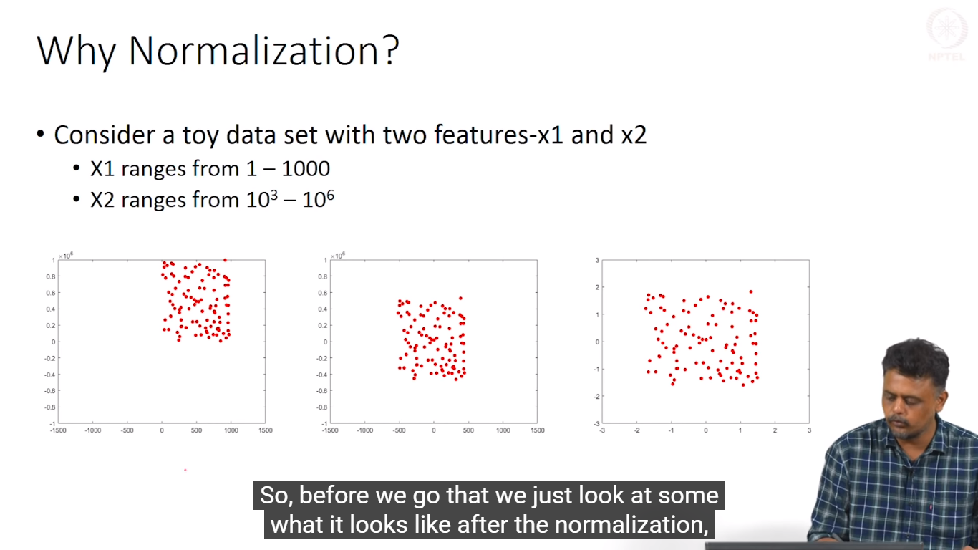
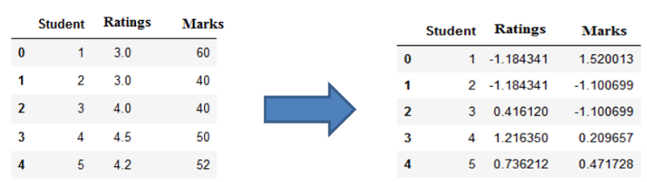

Slide 2
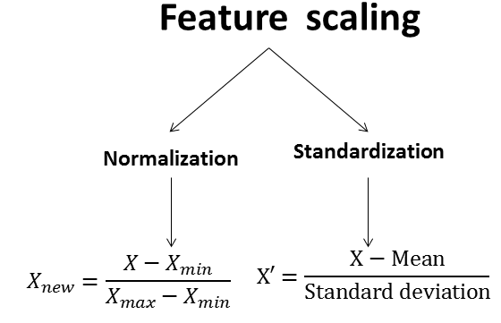

Slide 3
Normalization
min-max normalization
performs a linear transformation on the original data
z-score normalization
the values for an attribute A, are normalized based on the mean and standard deviation of A
normalization by decimal scaling
normalizes by moving the decimal point of values of attribute A.
The number of decimal points moved depends on the maximum absolute value of A

Slide 4
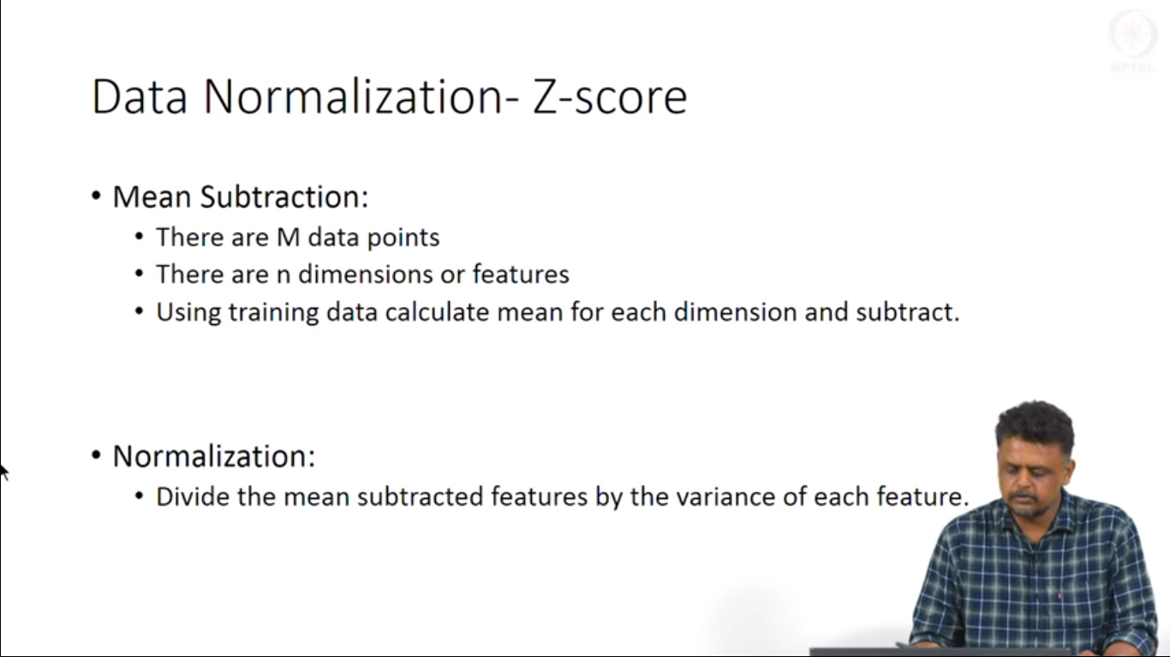

Slide 5
Transformation: Normalization
Min-max normalization: to [new_min_{A}, new_max_{A}]
Ex. Let income range $12,000 to $98,000 normalized to [0.0, 1.0]. Then $73,600 is mapped to
Z-score (Zero mean) normalization (μ: mean, σ: standard deviation):
Ex. Let μ = 54,000, σ = 16,000. Then

Slide 6
Transformation: Normalization
Normalization by decimal scaling
Where j is the smallest integer such that Max(|ν’|) < 1
Suppose that the recorded values of A range from -986 to 917. The maximum absolute value of A is 986.
To normalize by decimal scaling, we therefore divide each value by 1,000 (i.e., j = 3)
so that -986 normalizes to -0.986 and 917 normalizes to 0.917.

